Slide 1

MS-Copilot Feature File Generation
Cover design
These slide designs and messages are inspirational only. Please modify text boxes and positioning as needed based on the message and overall composition. Always consider the legibility and contrast of copy and content for maximum usability.
Any and all photography in these designs is given as an example. While you can use them, it’s better to change the photography to match your content.
To do so, right click on the picture or placeholder to change/insert a photo.
Where to find photography:
Photo library
Getty images (Recommended), Shutterstock, Adobe images (check with your M&C design team):
Further cover examples and inspiration are available in Extras file in your Powerpoint
-> File -> New from template…

Slide 2
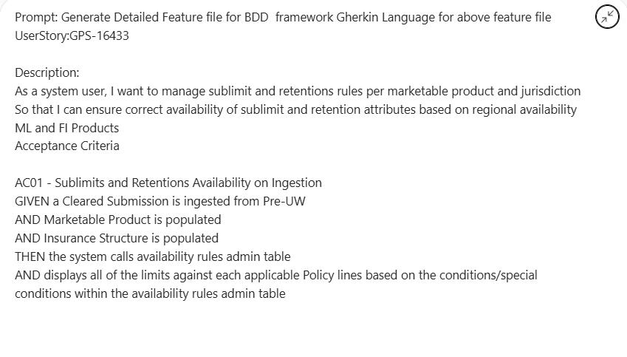
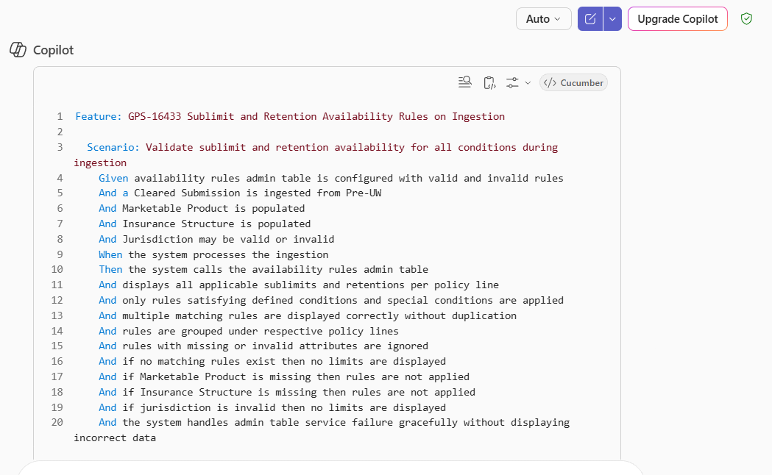
Creation of Feature file

Slide 3
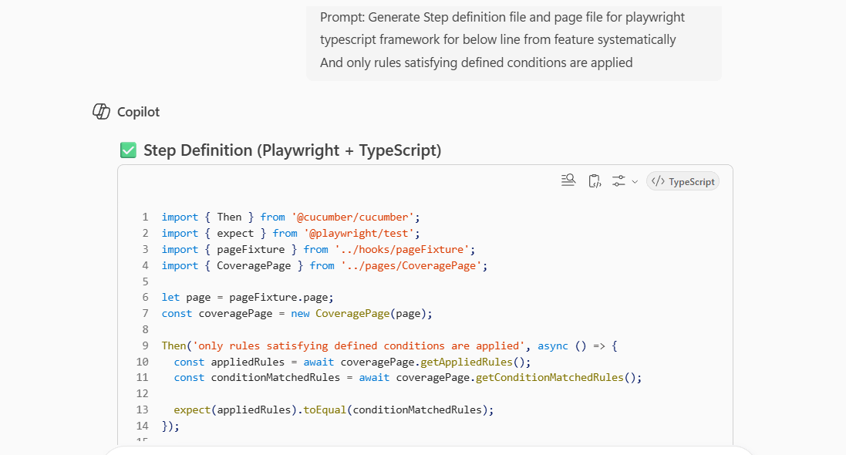
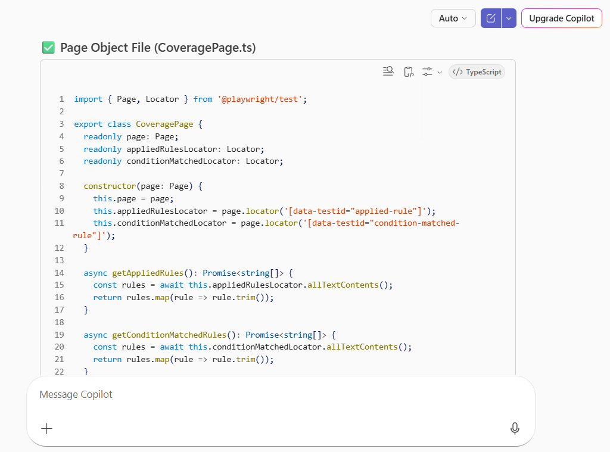
Creation of Step Definitions and page object file

Slide 4
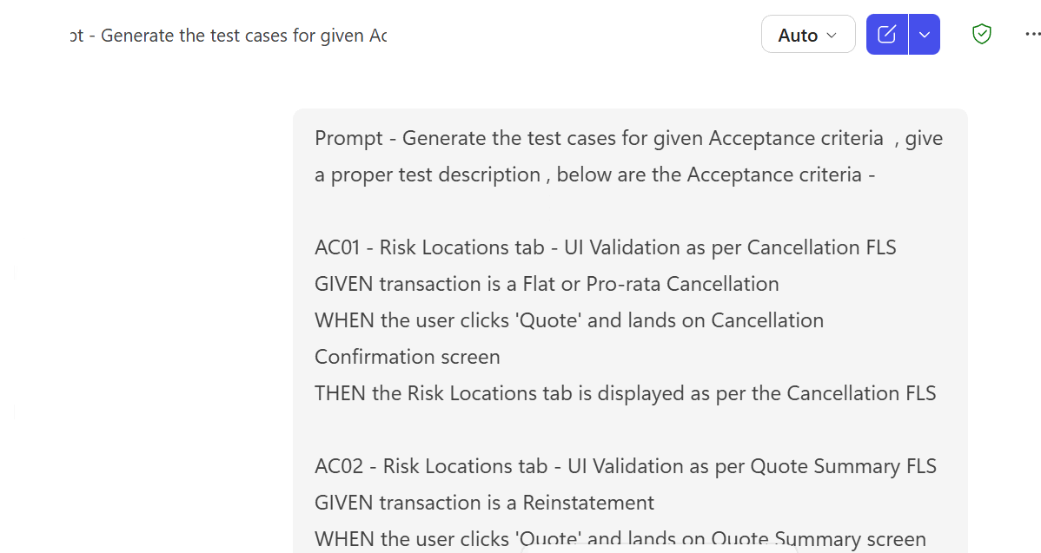
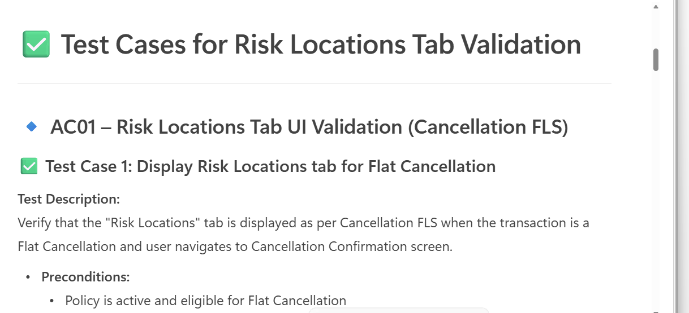
Creation of Test cases

Slide 5
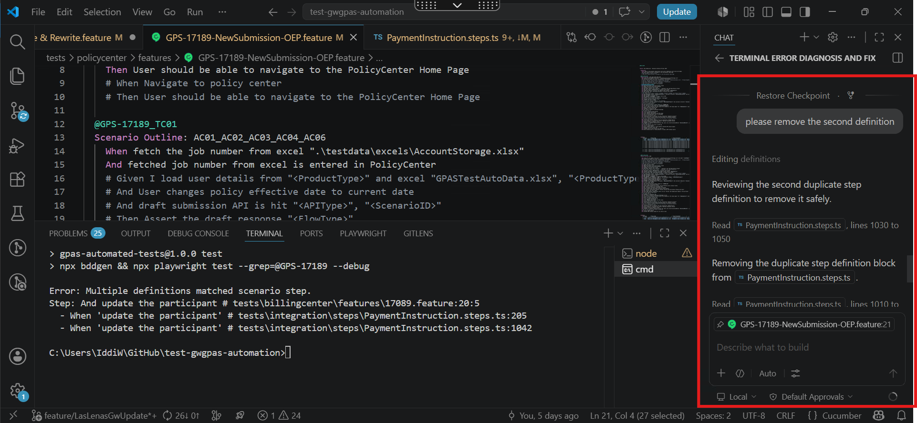
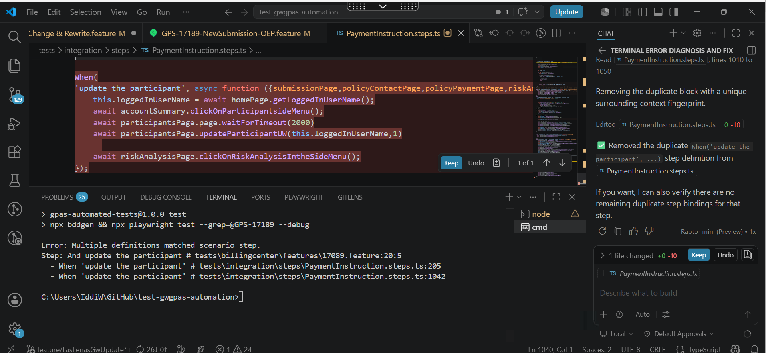
Debugging code

Slide 6
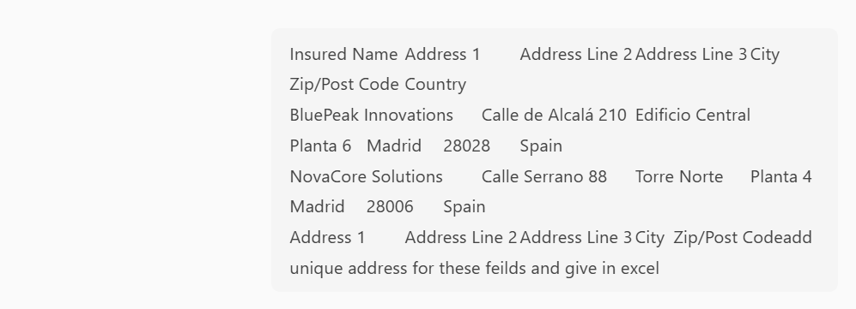
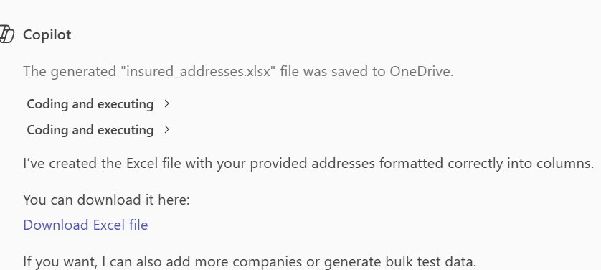
Creation of Test Data

Slide 7

Thank you.
Impact slides
These slide designs and messages are inspirational only. Please modify text boxes and positioning as needed based on the message and overall composition. Always consider the legibility and contrast of copy and content for maximum usability.
Any and all photography in these designs is given as an example. While you can use them, it’s better to change the photography to match your content.
To do so, right click on the picture or placeholder to change/insert a photo.
Where to find photography:
Photo library
Getty images (Recommended), Shutterstock, Adobe images (check with your M&C design team):
Further examples and inspiration are available in Extras file in your Powerpoint
-> File -> New from template…
Make it real.

